Slide 1
Module-01: C Programming Basics Part-2: Datatypes, Variables and Preprocessor Directives
CS 1714 – Computer Programming II

Slide 2
Data Types
Primitive data types in C include: int, float, double, and char.
Derived types, such as short, long, signed, and unsigned and their combinations also exist in C.
Types | Size in Bytes | Difference from Java
int | 4 | Same
double | 8 | Same
char | 1 | Java char’s are 2 bytes and support Unicode. C uses ASCII and char’s can be treated as an int.
We will not be using float.
Strings exist in C, but they work very differently and will be covered in a later presentation.

Slide 3
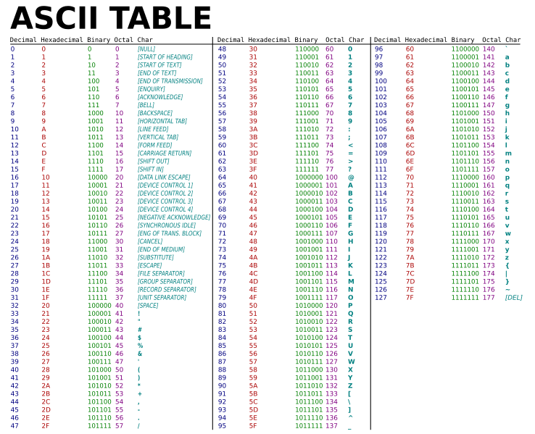
char and ASCII
char’s only have 256 possible characters based on the ASCII encoding chart.
This table shows all the possible characters.
char’s can be treated as an int with the values in the Decimal column of this chart, or the character in the Char column--the literal character needs to be surrounded by single quotes.

Slide 4
Variable Declarations
The syntax for variable declarations and initializations are the same in C as in Java.
In ANSI C, all variables must be declared at the top of the code block surrounded by the curly braces.
In later versions of C, you can declare the variables throughout the code block within these curly braces.
#include<stdio.h>
int main(int argc, char* argv[])
{
int foo = 0;
double bar = 0.0;
char c = 'A';
printf("This is my first C program\n");
return 0;
}
Even though it is not compulsory, it is good practice to keep all your variable declarations in one place.

Slide 5
Variable Declarations - Default Values
There are no default values for variables in C.
Always initialize your variables in C because their default values are indeterminant.
#include<stdio.h>
int main(int argc, char* argv[])
{
int foo = 0;
double bar = 0.0;
char c = 'A';
printf( "This is my first C program\n" );
return 0;
}
You do not need to initialize the variables if you will assign a value later on.

Slide 6
Variable Declarations - Default Values
In this example, we did not initialize the variable foo and we used it in initializing bar.
foo is not always guaranteed to have zero, so we do not know what foo or bar will have when this program runs.
foo will have whatever value was already in that memory location.
#include<stdio.h>
int main(int argc, char* argv[])
{
/* Bad Example */
int foo;
int bar = foo + 3;
printf("This is my first C program\n");
return 0;
}

Slide 7
Preprocessor Directives
Preprocessor directives (or macros) are instructions for replacement text done in the preprocessor stage of the compilation process. This is the first stage in the gcc compilation process.
We will primarily use preprocessor directives to create constant values. To create a preprocessor macro, we use a #define. #define needs an identifier followed by an expression. To start, the expression can be a single literal value, like a number.
Before the actual compilation stage, the preprocessor will go through the code to look for the <identifier> and replace it with the <expression>.
#define <identifier> <expression>

Slide 8
Preprocessor Directives
Here are some examples:
Notice that there is no assignment operator (the = sign) between the identifier and the value nor is there a semi-colon after this statement.
Where ever we see PI in our code, the preprocessor will replace PI with the expression after it. In this case, 3.14159. Where ever we see NUMBER_OF_SIDES_IN_A_TRIANGLE in our code, the preprocessor will replace it with 3.
#define PI 3.14159
#define NUMBER_OF_SIDES_IN_A_TRIANGLE 3
The class coding style convention dictates that all constant identifiers are capitalized. If multiple words make up the constant identifier, use underscore to separate each word.

Slide 9
#define and the Preprocessor
#define is resolved BEFORE compilation starts in the preprocessing stage. What happens is that BEFORE compiling the source code to convert it to assembly, the preprocessor will replace all instances of the identifier in our code with the expression that follows it in the #define statement.
#define SCORE 25
int value = SCORE * 15;
/* This statement is what is actually compiled */
int value = 25 * 15;

Slide 10
More about Replacement Values
Remember that the expression after the identifier in #define is replacement text. You can use arithmetic and other types of expressions.
As you can see in this example, SCORE was resolved to a 3 + 4. The preprocessor replaces the text and compiles the resulting statement. Notice how the resulting arithmetic expression is evaluated in terms of the order of operations.
#define SCORE 3 + 4
int value = SCORE * 15;
/* This statement is what is actually compiled */
int value = 3 + 4 * 15;

Slide 11
More about Replacement Values
Here is an example of replacement text problems where we include a semi-colon in the replacement text.
In the example with value1, the replacement text was at the end of the statement which resulted in a redundant semi-colon, but no syntax error. In the example with value2, the replacement text was in the middle of the expression causing an syntax error.
#define SCORE 3;
int value1 = SCORE;
int value1 = 3;; /* Two ;’s */
int value2 = SCORE / 2;
int value2 = 3; / 2; /* Error! */

Slide 12
Preprocessor Directives as Constants
Creating constants is the simplest use of #define. We will learn more complex uses (e.g., replacement text with nested expressions, parameterized macros).
You can declare local constant variables by using the keyword const; however, they are limited in scope.
#define directives are meant to be global. For now, they are declared outside and before your main().
#include <stdio.h>
#define MAX 3
int main( int argc, char * argv[] )
{
int foo = MAX * 4;
return 0;
}

